Slide 1

Law Reform in a Small State: Mauritius
The Experience of the Mauritius Law Reform Commission
By
Sabir KADEL, Chief Executive Officer LRC

Slide 2

Introduction: The Movement of History
History shapes the present and defines the future.
The colonial legacy continues through unresolved issues like the Chagos Islands.
Law reform is a means of completing decolonisation.
Repealing archaic laws ensures justice and sovereignty.
Fukuyama was wrong!!!

Slide 3
The legacy of colonial rule extends beyond mere geography, it is deeply embedded in our legal systems. It endures within statutes and codes that have remained unaltered long after the colonial banners were lowered.
In small states, the mission of law reform agencies is, at its core, a continuation of the decolonisation process—undertaken not through political upheaval, but through the meticulous dismantling of legal vestiges that no longer serve a just and sovereign society.

Slide 4
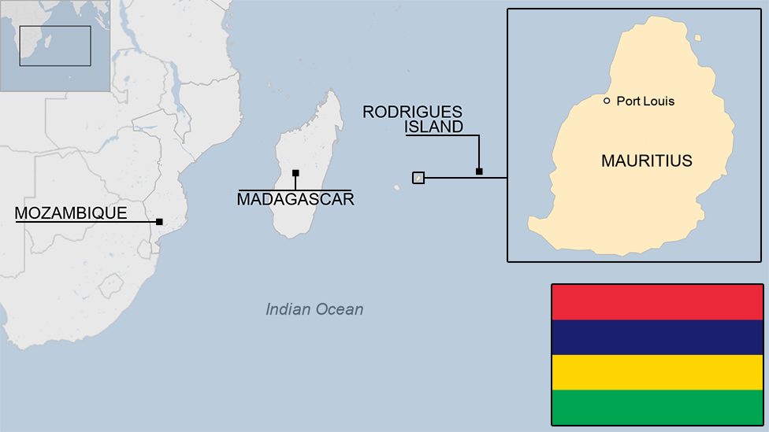
I. Mauritius Law Reform Commission (LRC)
Established under the Law Reform Commission Act 2005.
Independent statutory body ensuring laws remain just and relevant.
Functions:
Reviewing outdated laws;
Proposing reforms based on human rights and constitutional principles;
Engaging stakeholders for participatory law reform.

Slide 5
The Commission has the power inter alia to:
Initiate proposals for the review, reform or development of any aspect of the law of Mauritius and to receive and consider any such proposal made or referred to it by the Attorney-General or any other person;
Conduct public hearings, seek comments from the public on its proposals, and consult any person or class of persons;
Request information from any Government department, any organisation or person in relation to the review, reform or development of any aspect of the law of Mauritius; and
Publicise such parts of its work in such manner as it thinks expedient.

Slide 6
The working methodology of the LRC embodies a commitment to both rigour and inclusivity. At its core lies comparative legal analysis, which enables us to assess Mauritian laws in light of international standards and best practices. However, our approach is not one of mere legal transposition, we do not adopt foreign models uncritically.
Instead, we examine how similar challenges have been addressed across diverse legal systems, carefully evaluating which solutions can be tailored to our unique legal framework and socio-cultural realities. This ensures that our reforms are both globally informed and locally grounded.

Slide 7
LRC Recommendations Since 2006
186 Reports and Papers submitted to the Attorney-General with recommendations for change
Category | Details
Strengthening the Rule of Law & Human Rights | Rule of Law, Good Governance, Human Rights Protection
Improving Judicial System & Legal Services | Enhancing legal profession, settlement of disputes
Modernising Civil Justice System | Reforming outdated civil procedures
Modernising Criminal Justice System | Criminal procedures, Bail laws, Jury trials, Disclosure, Costs, Evidentiary rules, Review of miscarriages of justice
Renovating Criminal Law | Updating Criminal Code, offences, supplementary acts
Modernising Code Civil Mauricien | Law on persons, family law, obligations, contracts, property law, private international law
Improving Business Legal Infrastructure | Reform of Code de Commerce, real estate regulations, consumer protection, Cape Town Convention domestication

Slide 8
II. Dismantling Colonial Legal Vestiges
Colonial laws persist in Mauritius' legal framework.
Some outdated provisions include:
(A) Section 242: "Crime of Passion" defense
“Manslaughter committed by any person on his spouse, as well as on his accomplice, at the very moment he finds them in the act of adultery is excusable.”
(B) Section 250: Criminalisation of consensual sodomy
“Any person who is guilty of the crime of sodomy or bestiality shall be liable to penal servitude for a term not exceeding 5 years.”
(C) The Persistence of Provisional Charges in Mauritian Criminal Procedure
LRC aims to modernise these laws for justice and equality.

Slide 9
(A) Repealing Section 242:
Crime of Passion
Allows reduced punishment for killing a spouse caught in adultery.
Rooted in patriarchal notions of honor and possession.
Reinforces gender-based violence and contradicts equality principles.
LRC advocates repeal to ensure homicide is treated equally in all cases.

Slide 10
This legal doctrine is not merely outdated; it is inherently perilous. By enshrining in law the notion that emotions—especially jealousy and betrayal—can serve as a partial justification for taking a human life, it legitimises and perpetuates gender-based violence.
Such a provision is fundamentally at odds with contemporary principles of gender equality, human rights, and due process, all of which require that homicide be adjudicated with unwavering consistency, without regard to the perpetrator’s emotional state. Murder must be recognised for what it is—an act that demands full accountability under the law.

Slide 11
(B) Reforming Section 250: Decriminalisation of Consensual Sodomy
Colonial-era law criminalised consensual sodomy.
Rooted in Victorian morality rather than indigenous legal traditions.
Supreme Court decriminalised sodomy in 2023 between consensual male adults (Ah Seek v State of Mauritius).
LRC proposed a consent-based approach to legal reform.

Slide 12
Insertion of a new Section 47 in the Mauritian Criminal Code
“(a) Notwithstanding any provision in this Code to the contrary, any act between consenting adults, where the individuals have the capacity to give consent, shall be deemed to be lawful, provided that such act:
(i) Does not result in non-consensual harm to others;
(ii) Does not involve coercion, duress, manipulation, or undue influence; and
(iii) Does not violate public order or public policy.
(b) For the purpose of this section, ‘consent’ shall mean the free and informed agreement to the act by the person concerned.
(i) Consent must be established at every stage of the act. It must be ongoing, freely given, informed, and reversible at any point.
(ii) An individual is incapable of giving consent if the individual is incapacitated due to the use of drugs or alcohol, or is unable to understand the nature or condition of the act.

Slide 13
The proposed Section 47, inspired by Section 228 of the German Criminal Code, seeks to enshrine a fundamental legal principle that prioritises consent and individual autonomy.
This provision would effectively decriminalise consensual sodomy under Section 250 of the Mauritian Criminal Code by affirming that any act between consenting adults is lawful, provided specific safeguards are met. By establishing a clear standard, the new provision would override conflicting sections of the Criminal Code, ensuring that individuals engaging in private, consensual conduct are not subjected to criminal prosecution, thereby aligning Mauritian law with modern human rights principles.

Slide 14
(C) Doing away with provisional charges
A significant legal anomaly in Mauritius is that no statute explicitly recognizes or defines the concept of a provisional charge. Yet, it remains widely used by the police and has been accepted by the judiciary as a de facto part of the criminal justice system.
Despite the absence of any explicit legal provision authorizing their use, "provisional charges" remain a distinctive and controversial feature of the Mauritian criminal justice system. Rooted in British colonial legal traditions, this practice has persisted without a clear statutory basis, allowing for frequent abuse by law enforcement authorities. The lack of judicial oversight and defined procedural safeguards has resulted in numerous instances of arbitrary arrest and extended detentions without proper cause.
The Law Reform Commission of Mauritius has recognized these deficiencies and has advocated for the introduction of legislative reforms akin to the UK’s Police and Criminal Evidence Act 1984 (PACE), which governs police investigations, arrests, and charging procedures with a strong emphasis on safeguarding the rights of suspects. This note examines the legal vacuum surrounding provisional charges, their abuse by the police, and the urgent need for legislative reform in light of comparative experiences, particularly the UK, France, and South Africa.

Slide 15
The abolition or reform of provisions such as Sections 242 and 250, and doing away with provisional charges is not an isolated initiative, it is part of a broader imperative to purge our legal system of colonial remnants that no longer serve a legitimate purpose.
These laws were not designed to safeguard the rights of the local population but were imposed by colonial rulers to enforce a moral and social order detached from the realities and values of the people they governed. Their continued existence is anachronistic, and their repeal is essential to ensuring a legal framework that reflects justice, equality, and the sovereignty of our nation.

Slide 16
III. Future of Law Reform in Mauritius
Strengthening LRC’s independence and impact.
Expanding regional and Commonwealth collaborations.
Promoting people-centric law reform.
Ensuring laws reflect contemporary values and societal needs.

Slide 17
Conclusion
Law reform in small states is crucial for sovereignty.
LRC ensures outdated, unjust laws are repealed.
Reforming laws is a moral and historical responsibility.
The law must evolve to reflect modern principles of justice.

Slide 18

Thank you!

