Slide 1
Commonwealth Association of Law Reform Agencies Conference, 2023
Reflections on the Setting Up of the Seychelles Law Commission
Venue: The Cidade De Goa Resort, Goa, India, on 4 March, 2023
Mr. Stefan R. Knights,
Consultant to Attorney General’s Chambers, Seychelles

Slide 2
OBJECTIVES
To highlight and discuss the factors that influenced the enactment of the Law Commission Act, 2022.
To highlight some of the key features of the Law Commission Act, 2022.
To highlight a few recommendations that CALRAs can consider in terms of supporting new law reform agencies.

Slide 3
About the Presenter
Attorney-at-Law and Legislative Counsel
PhD Candidate in the area of Law Reform (IALS, University of London)
Currently responsible for establishing the Seychelles Law Commission
Experience managing Law Reform and Law Revision Projects in various jurisidctions
Recipient of Commonwealth Scholarship to study at the University of St Andrews (Scotland)

Slide 4
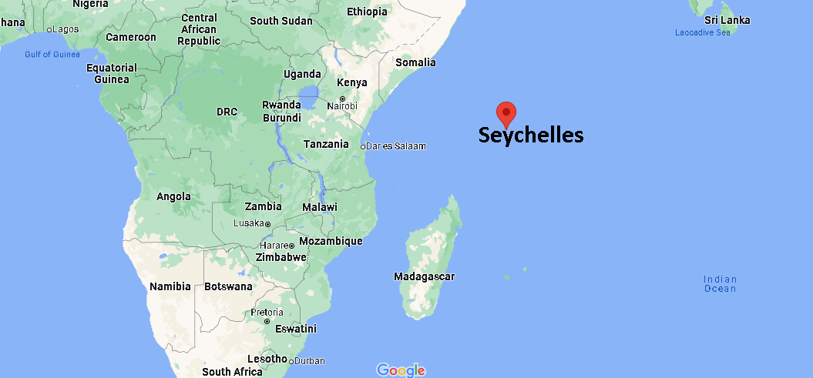
Seychelles Legal History

Slide 5
Seychelles Legal History

Slide 6
Seychelles Legal History

Slide 7
Calls for Law Reform

Slide 8
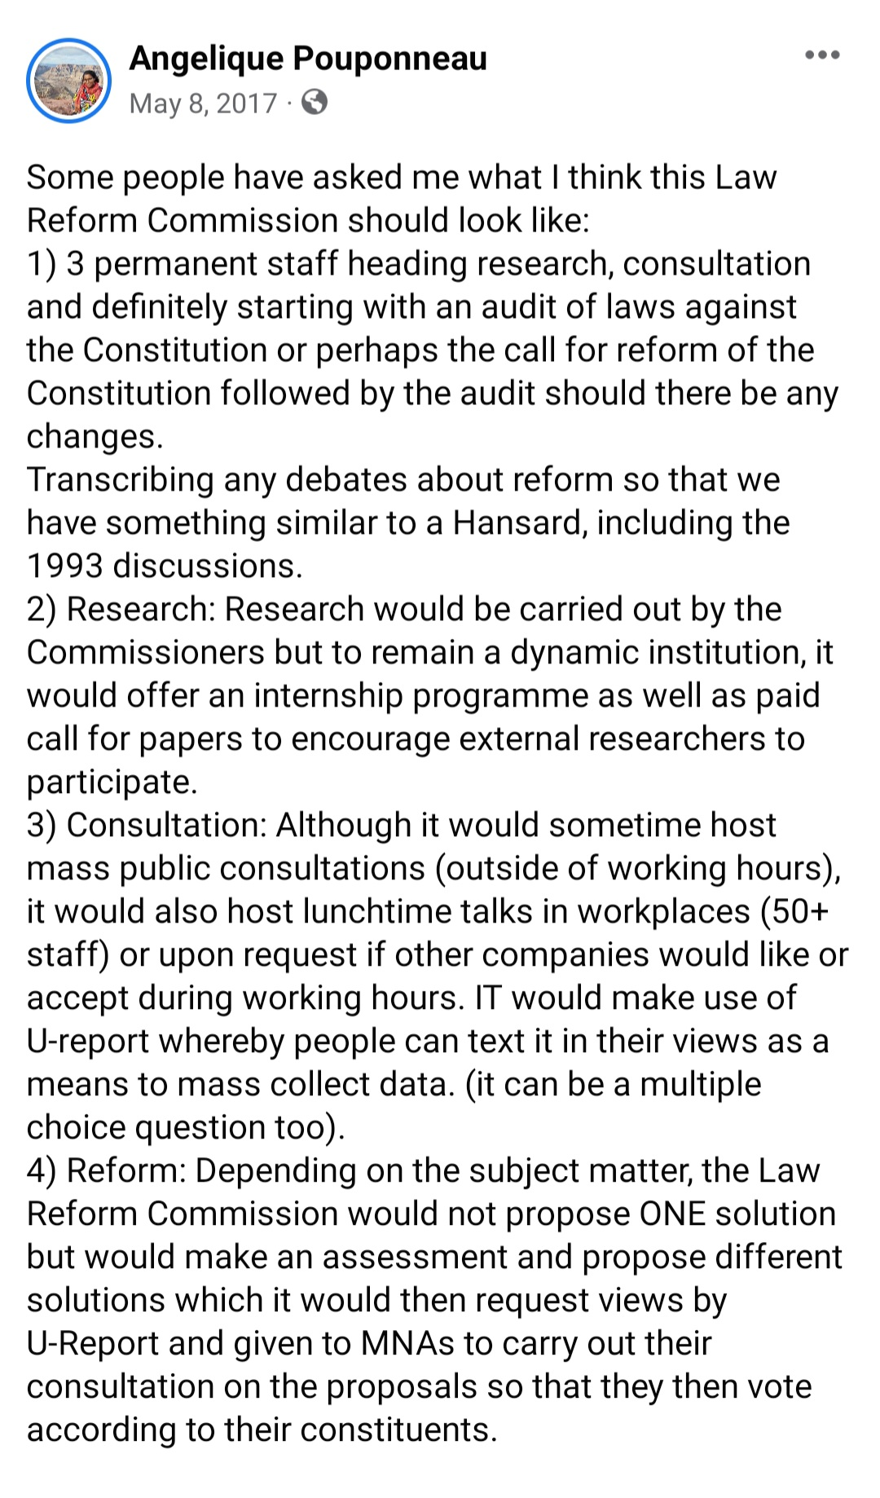

Slide 9
Implementing the Attorney General’s Vision
Visit to the Mauritius Law Reform Commission and Law Revision Unit in the Mauritius Attorney General’s Chambers;
Visit to the Cayman Islands Law Reform Commission and Office of the Law Revision Commissioner
Analysis of laws on law reform and law revision in the Bahamas; Jamaica; St Kitts and Nevis; Vanuatu; Fiji and Samoa.

Slide 10
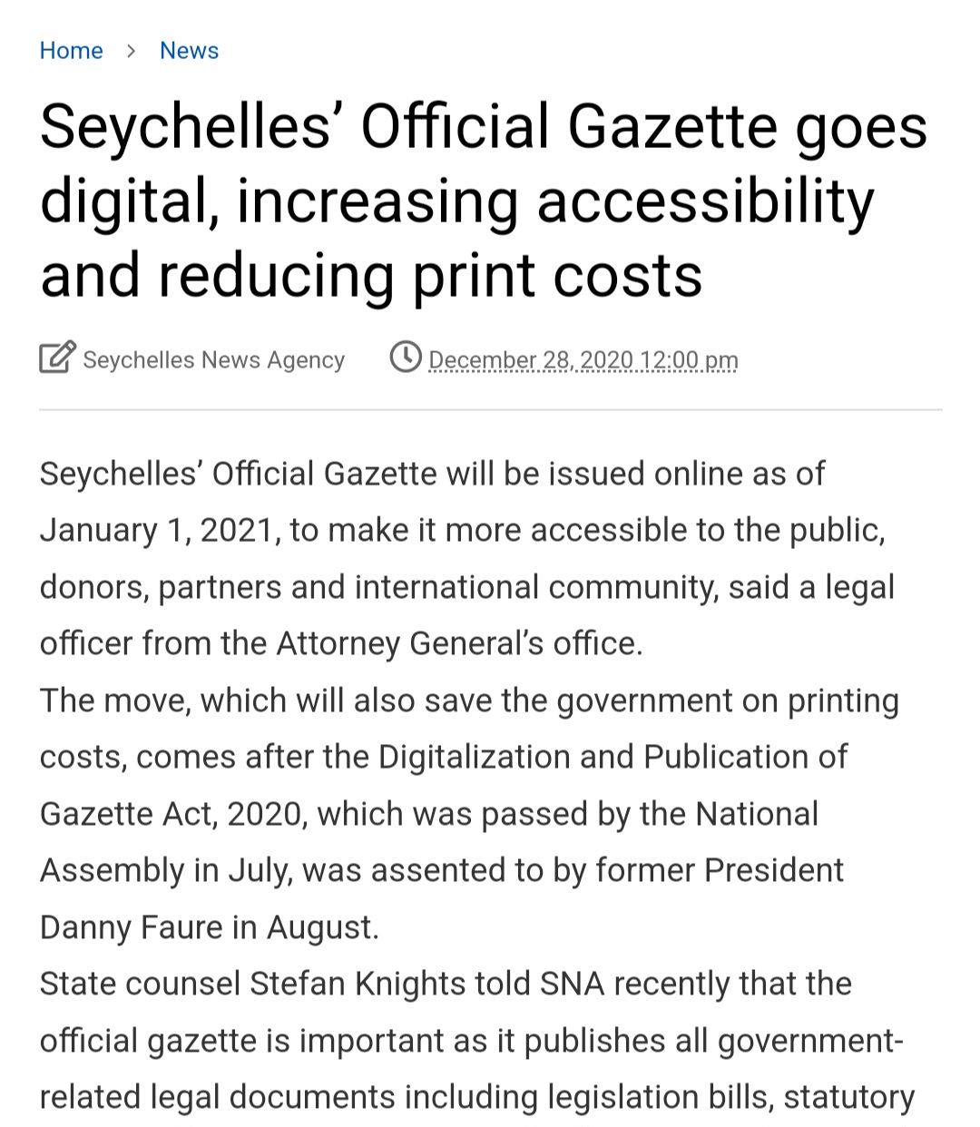
Financial Challenges to Law Revision
Rethinking our approach to the Gazette

Slide 11
Law Revision Project

Slide 12
Financing Seychelles Law Commission
1/3 of the National Budget allocated to the Truth, Reconciliation and National Unity Commission;
Assets and Property of theTruth, Reconciliation and National Unity Commission

Slide 13
Political Support for the Seychelles Law Commission
Minister of Foreign Affairs during UPR Address
Vice President of Seychelles in the National Assembly of Seychelles

Slide 14
Membership of the Law Commission
(a) the Attorney General;
(b) a Justice of Appeal proposed by the President of the Court of Appeal of Seychelles;
(c) a Judge proposed by the Chief Justice;
(d) a member of the National Assembly proposed by the Speaker in consultation with the Leader of the Opposition and the Leader of Government Business;
(e) 2 Attorneys-at-Law proposed by the Attorney General in consultation with the Bar Association of Seychelles and Citizens Engagement Platform Seychelles;
(f) the Director who shall be an ex-officio member

Slide 15
Functions of the Directors
The Director will be the administrative head of the Commission and the Director shall be responsible for —
(a) the administration of the Commission;
(b) the conduct of legal research for the Commission;
(c) the preparation of draft legislation, reports and other documents for the use of the Commission;
(d) such other tasks that are necessary to ensure that the Commission fulfils its functions.

Slide 16
Main Functions of the Commission
Law Revision
Law Reform
Scrutiny of legislation
Law Reporting
Discussion Papers

Slide 17
Financial Provisions
The funds available to the Commission shall comprise —
(a) monies allocated by the National Assembly from the Consolidated Fund;
(b) monies given to the Commission by a foreign country, international organization or a non-governmental agency or body for a general or specific purpose, or for the remuneration and benefit of a consultant;
(c) donations, endowments and other gifts received by the Commission on the approval of the Minister.

Slide 18
Ongoing Work
Operational matters – rules, policies, programme of work for 2023/24 etc
Recruitment of Staff
Setting up of Office

Slide 19
Recommendations
Development of work programme
Comparative legal research skills
Post-legislative scrutiny
Partnerships amongst Commissions
Collaborations with other organizations
Great platform for engagement and networking

Slide 20
Thank you!
Mr. Stefan R. Knights
Consultant

