Slide 1
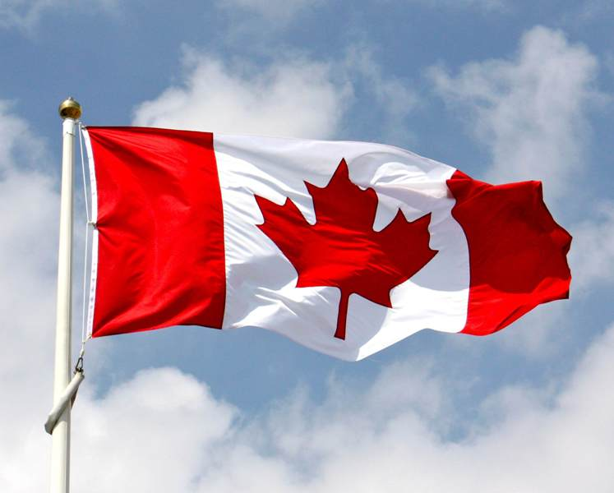
Commonwealth Association of Law Reform Agencies Encouraging international cooperation on law reform
CALRAs Conference 2023: Goa
International Co-operation on Law Reform
Federation of Law Reform Agencies of Canada
FOLRAC
Commonwealth Association of Law Reform Agencies
Encouraging international cooperation on law reform
This Photo by Unknown Author is licensed under CC BY-SA-NC

Slide 2
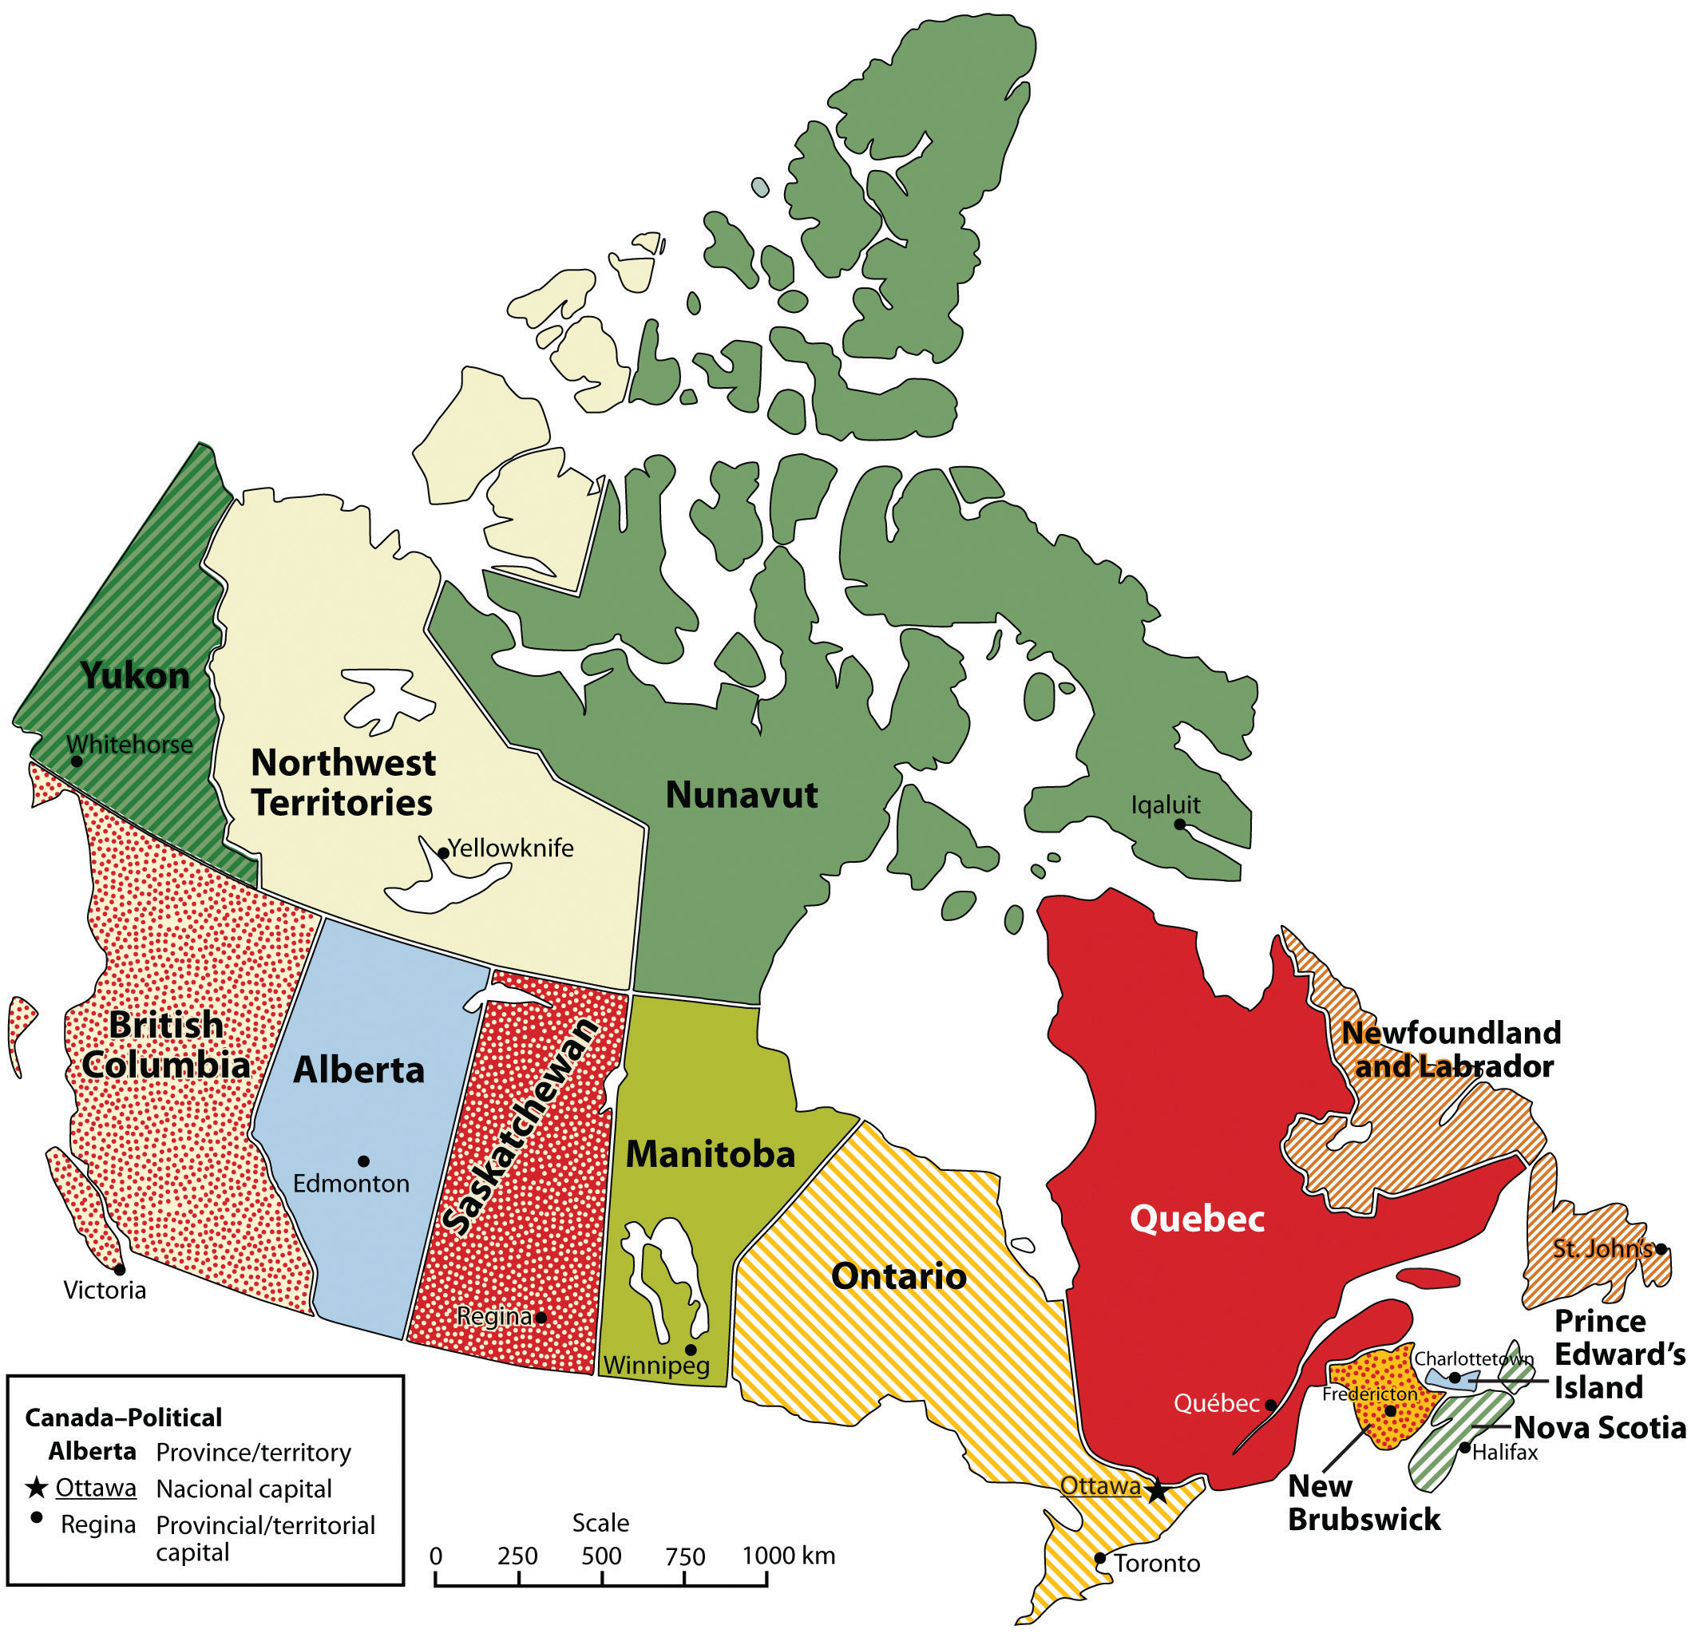
Commonwealth Association of Law Reform Agencies Encouraging international cooperation on law reform
Members
Alberta Law Reform Institute
British Columbia Law Institute
Manitoba Law Reform Commission
Access to Justice and Law Reform Institute of
Nova Scotia
Law Commission of Ontario
Law Reform Commission of Saskatchewan
Institute Quebecois de Reform du Droit et de la Justice
This Photo by Unknown Author is licensed under CC BY-SA-NC

Slide 3
Commonwealth Association of Law Reform Agencies Encouraging international cooperation on law reform
Leadership Team of 6, drawn from member agencies
Objectives are set out, and include eg to:
advance law reform in Canada;
Encourage growth of co-operation between LRAs
Educate public on the role of LRAs
Provide a forum for LRAs to meet
Co-operate with other organisations

Slide 4
Commonwealth Association of Law Reform Agencies Encouraging international cooperation on law reform
Background: Uniform Law Conference of Canada
1990 – FOLRAC incorporated;
and 1990, first separate meeting of LRAs outwith Uniform Law Conference of Canada
2010 Symposium: FOLRAC decision to focus on being a vehicle for Canada’s LRAs to share information and assist each other

Slide 5
Commonwealth Association of Law Reform Agencies Encouraging international cooperation on law reform
FOLRAC Website: www.folrac.com
FOLRAC Roundup published on homepage every 3 months; list of LRA publications with links
Publicity for LRA events
FOLRAC pays for domain name and hosting;
Alberta LRI provide staff time to generate content and update website. ALRI is the longstanding full-time LRA in Canada and has a mentoring role

Slide 6
Commonwealth Association of Law Reform Agencies Encouraging international cooperation on law reform
Regular FOLRAC Symposiums, hosted by member LRA – last one in 2018 in Alberta; next in June 2023 in Ontario
FOLRAC charges an annual small fee to members, to cover website expenses and a grant to a member to host the Symposium
International engagement on law reform: undertaken by LRAs not FOLRAC

