Slide 1
The Hon. Anthony North KC, Chair
Victorian Law Reform Commission
The office of the Victorian Law Reform Commission is located on the land of the Traditional Custodians, the people of the Kulin Nations. We acknowledge their history, culture and Elders both past and present.

Slide 2
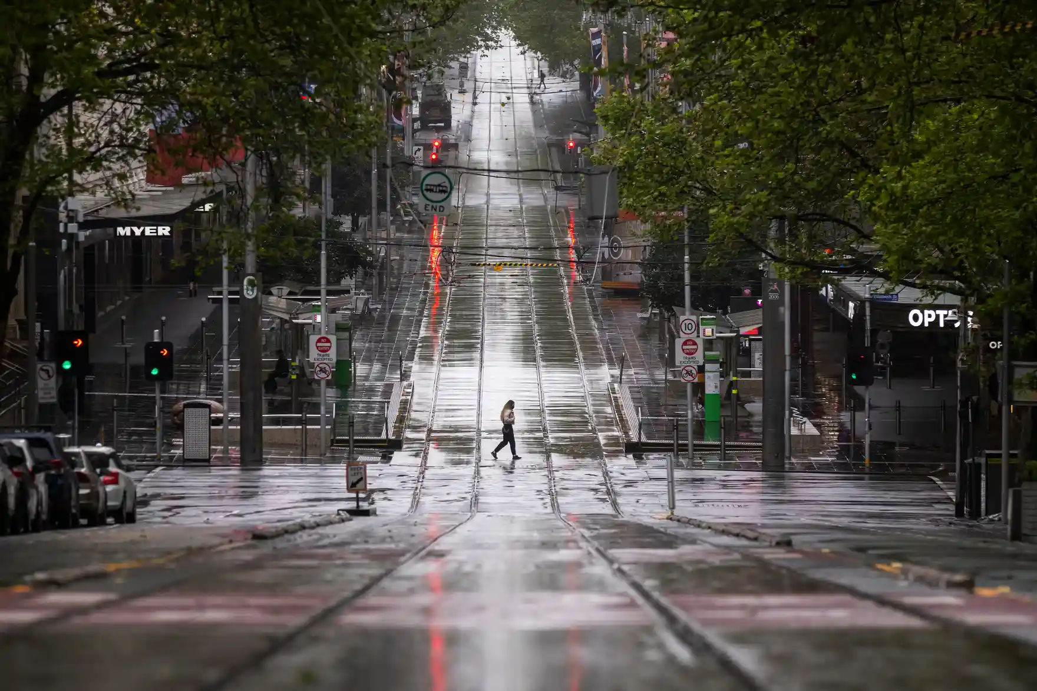
‘Consultation and engagement during the pandemic’
The office of the Victorian Law Reform Commission is located on the land of the Traditional Custodians, the people of the Kulin Nations. We acknowledge their history, culture and Elders both past and present.

Slide 3
What is the Victorian Law Reform Commission?
The office of the Victorian Law Reform Commission is located on the land of the Traditional Custodians, the people of the Kulin Nations. We acknowledge their history, culture and Elders both past and present.

Slide 4
THE BASICS
> Independent, government-funded organisation.
> Established by the Victorian Law Reform Commission Act 2000 (Vic)
> Central agency for developing law reform in Victoria, Australia.
The office of the Victorian Law Reform Commission is located on the land of the Traditional Custodians, the people of the Kulin Nations. We acknowledge their history, culture and Elders both past and present.

Slide 5
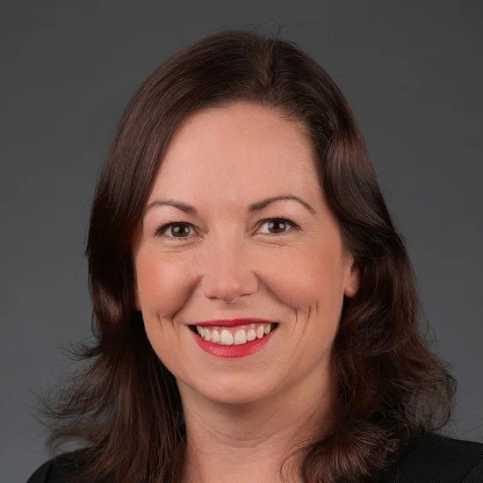
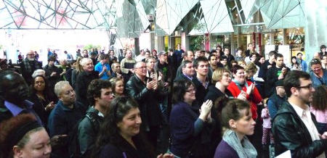
Source of inquiries
References Referred by the Attorney-General, the Hon. Jaclyn Symes
Community Law Reform Projects Suggested by the community and initiated by the Commission
The office of the Victorian Law Reform Commission is located on the land of the Traditional Custodians, the people of the Kulin Nations. We acknowledge their history, culture and Elders both past and present.

Slide 6
Three key principles:
Inclusive
Independent
Innovative
The office of the Victorian Law Reform Commission is located on the land of the Traditional Custodians, the people of the Kulin Nations. We acknowledge their history, culture and Elders both past and present.

Slide 7
The pandemic in Victoria
The office of the Victorian Law Reform Commission is located on the land of the Traditional Custodians, the people of the Kulin Nations. We acknowledge their history, culture and Elders both past and present.

Slide 8
The office of the Victorian Law Reform Commission is located on the land of the Traditional Custodians, the people of the Kulin Nations. We acknowledge their history, culture and Elders both past and present.

Slide 9
The office of the Victorian Law Reform Commission is located on the land of the Traditional Custodians, the people of the Kulin Nations. We acknowledge their history, culture and Elders both past and present.

Slide 10
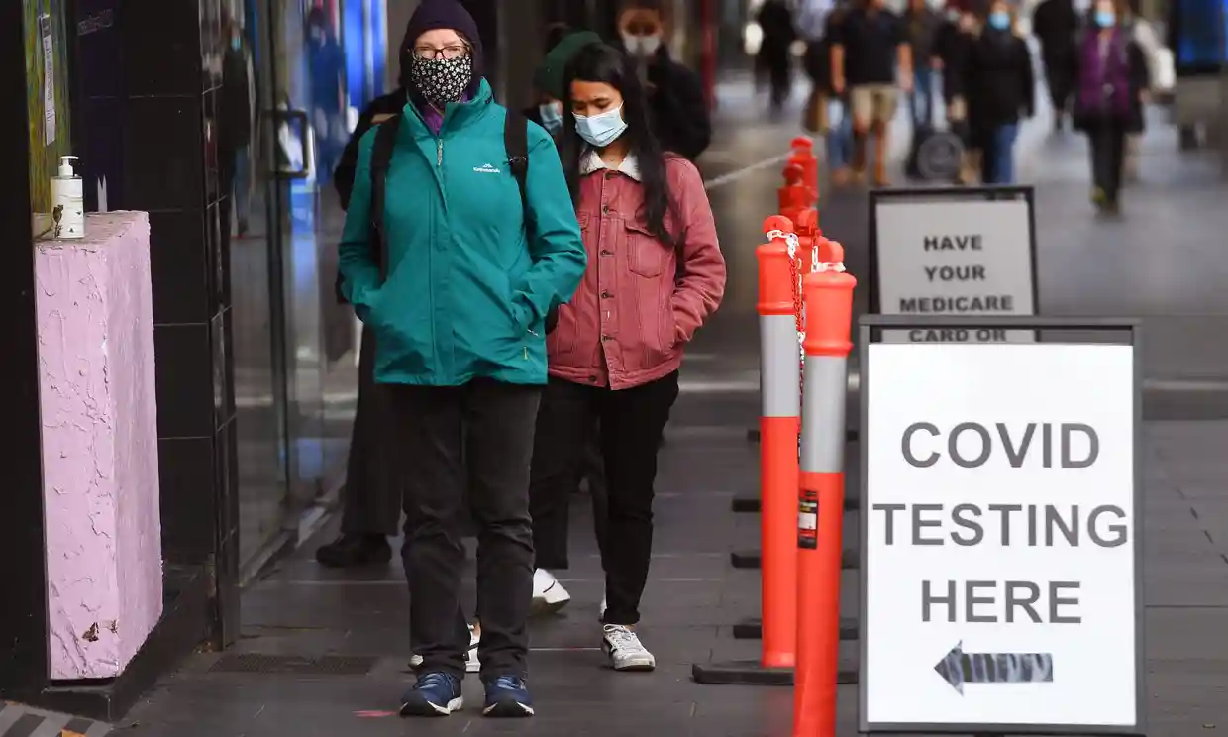
The office of the Victorian Law Reform Commission is located on the land of the Traditional Custodians, the people of the Kulin Nations. We acknowledge their history, culture and Elders both past and present.

Slide 11
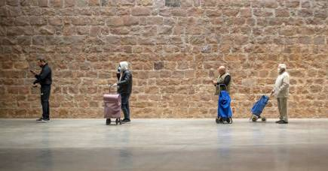
The office of the Victorian Law Reform Commission is located on the land of the Traditional Custodians, the people of the Kulin Nations. We acknowledge their history, culture and Elders both past and present.

Slide 12
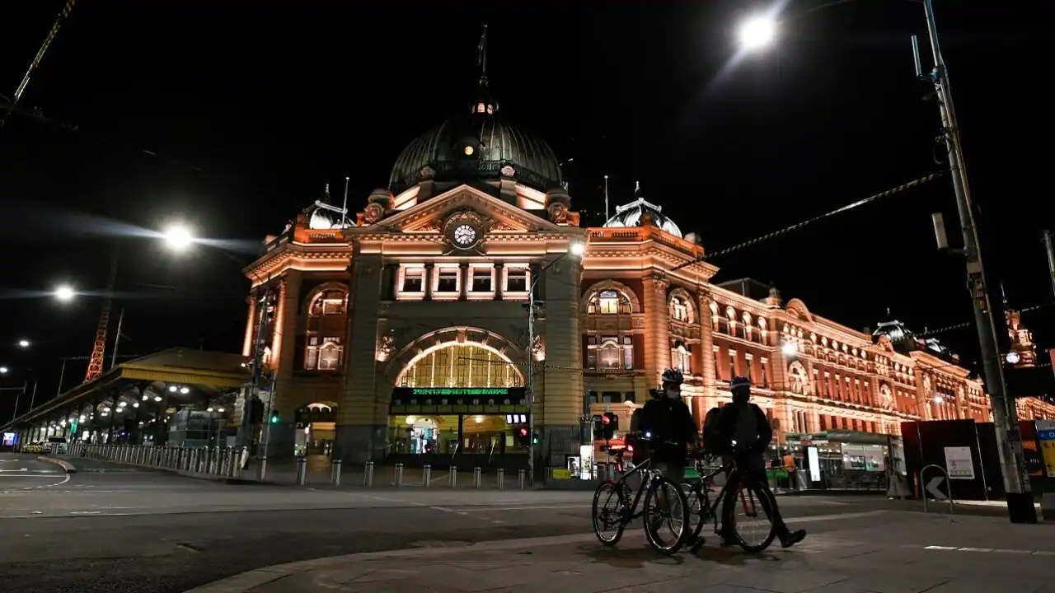
The office of the Victorian Law Reform Commission is located on the land of the Traditional Custodians, the people of the Kulin Nations. We acknowledge their history, culture and Elders both past and present.

Slide 13
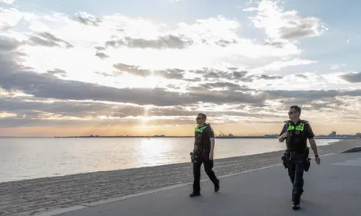
The office of the Victorian Law Reform Commission is located on the land of the Traditional Custodians, the people of the Kulin Nations. We acknowledge their history, culture and Elders both past and present.

Slide 14
The office of the Victorian Law Reform Commission is located on the land of the Traditional Custodians, the people of the Kulin Nations. We acknowledge their history, culture and Elders both past and present.

Slide 15
Our projects
The office of the Victorian Law Reform Commission is located on the land of the Traditional Custodians, the people of the Kulin Nations. We acknowledge their history, culture and Elders both past and present.

Slide 16
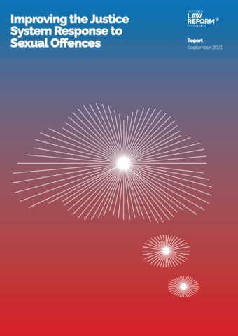
THE Sexual offences inquiry
The office of the Victorian Law Reform Commission is located on the land of the Traditional Custodians, the people of the Kulin Nations. We acknowledge their history, culture and Elders both past and present.

Slide 17
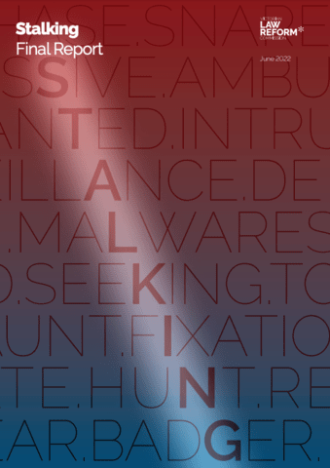
THE stalking inquiry
The office of the Victorian Law Reform Commission is located on the land of the Traditional Custodians, the people of the Kulin Nations. We acknowledge their history, culture and Elders both past and present.

Slide 18
THE INCLUSIVE JURIES PROJECT
A Community Law Reform Project
The office of the Victorian Law Reform Commission is located on the land of the Traditional Custodians, the people of the Kulin Nations. We acknowledge their history, culture and Elders both past and present.

Slide 19
How we adjusted
The office of the Victorian Law Reform Commission is located on the land of the Traditional Custodians, the people of the Kulin Nations. We acknowledge their history, culture and Elders both past and present.

Slide 20
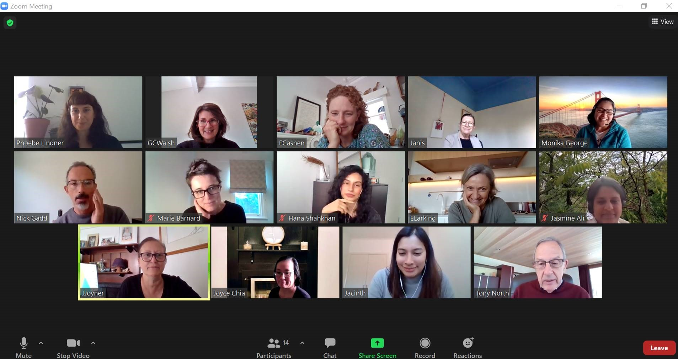
The office of the Victorian Law Reform Commission is located on the land of the Traditional Custodians, the people of the Kulin Nations. We acknowledge their history, culture and Elders both past and present.

Slide 21
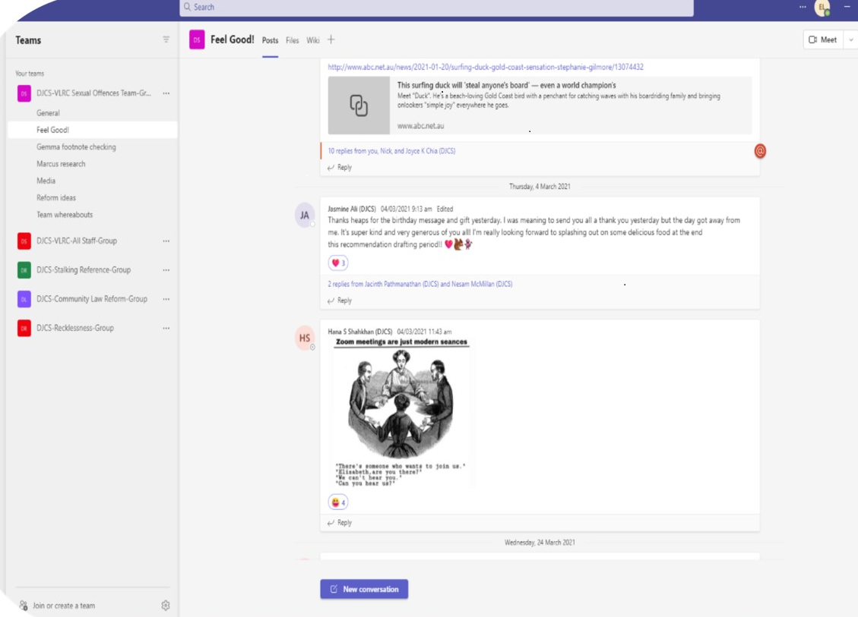
How we adjusted
The office of the Victorian Law Reform Commission is located on the land of the Traditional Custodians, the people of the Kulin Nations. We acknowledge their history, culture and Elders both past and present.

Slide 22
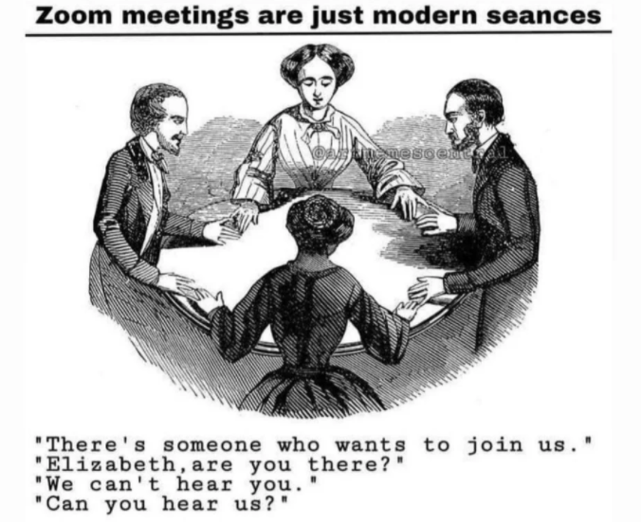
The office of the Victorian Law Reform Commission is located on the land of the Traditional Custodians, the people of the Kulin Nations. We acknowledge their history, culture and Elders both past and present.

Slide 23
The Hon. Anthony North KC, Chair
Victorian Law Reform Commission
The office of the Victorian Law Reform Commission is located on the land of the Traditional Custodians, the people of the Kulin Nations. We acknowledge their history, culture and Elders both past and present.

