Slide 1
Matthew Jolley Head of Legal - Law Commission of England & Wales

Slide 2
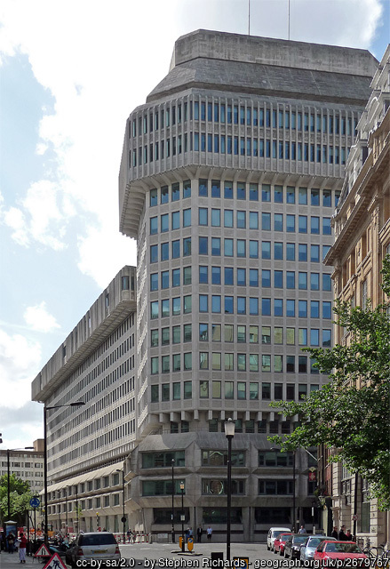
About the LCEAW
What are we?
Statutory Arm’s Length Body
Sponsored by the Ministry of Justice
Independent from Government

Slide 3
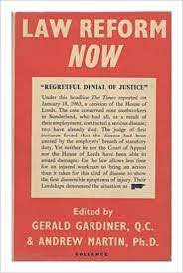
Our history

Slide 4
England and WALES

Slide 5
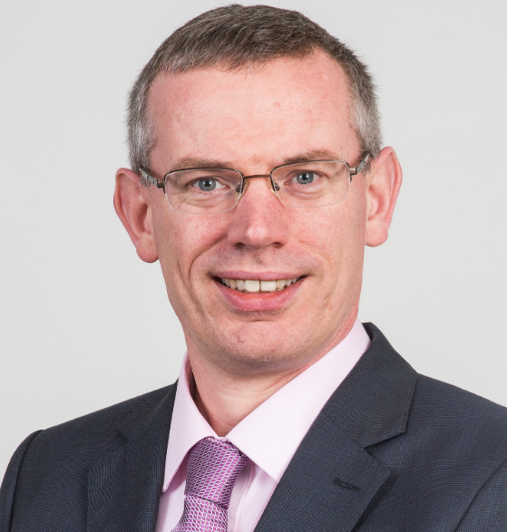
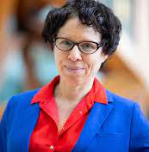
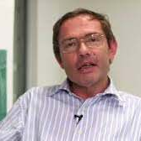
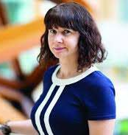
Who are we?
Chairman and 4 Commissioners
Currently about 70 staff
Lawyers, research assistants, Parliamentary Counsel, economist, small corporate services team
Sir Nicholas Green, Chair
Prof Nick Hopkins, Property, Family and Trust Law
Prof Penney Lewis,
Criminal Law
Nicholas Paines KC,
Public and Welsh Law
Prof Sarah Green, Commercial and Common Law

Slide 6
Our role
Aim to make the law in E&W:
Simple
Accessible
Fair
Modern
Cost-effective

Slide 7
Current work
Contempt of court | Surrogacy
Remote driving and autonomous vehicles | Digital assets: electronic trade documents
Criminal appeals | Wills
Review of the trial process in sexual offences | Decentralised autonomous organisations

Slide 8
Current work (continued)
Disposal of the Dead | Compulsory purchase
Confiscation and the proceeds of crime | Planning law in Wales
Wills | Arbitration Act
Residential leasehold | Autonomy in aviation

Slide 9
Our process

Slide 10
Consultation and engagement
Three preliminary points
Access to technology
Expertise
And…

Slide 11
“Don’t teach your grandmother to suck eggs”

Slide 12
Phases of engagement
When are we engaging?
Pre-project
Business as usual engagement
Programme consultation
Pre-consultation
Formal consultation period
Post-consultation
Post-report/implementation

Slide 13
Our audience
Who are we engaging with?
Legal experts
Professionals
The judiciary
Academics
Representative groups
Charities and businesses
Government
The public

Slide 14
Methods of engagement
Traditional types of engagement
Bilaterals
Roundtables
Symposia
Conferences
“Town halls”

Slide 15
Digital media

Slide 16
Then…

Slide 17
And…

Slide 18
Resulting in…

Slide 19
Which looked like this…

Slide 20
Problems with the tech…

Slide 21
Other problems…

Slide 23
... but finally we started to learn

Slide 25
Restricted events
Replicate larger public events / events with an audience.
MS “Teams live” allows Commissioners and staff to speak to up to 10,000 attendees.
Guests cannot speak or show their video, with all engagement taking place through the chat box.
Questions and comments answered during the event, replicating – as far as possible – the Q&A section of a physical event.

Slide 26
Unrestricted events
Replicate stakeholder meetings and smaller stakeholder events.
All participants can speak whilst Commission staff will still maintain control over the event.
Allows for in-depth discussion between participants, replicating the aims of the physical version of these types of events.

Slide 27
Advantages for stakeholders
Availability
Time
Cost
Anonymity
Accessibility

Slide 28
Advantages for us
Time
Cost
Reach
Control

Slide 29
Disadvantages
Decline in interaction
During the event
Around the edges of the event
Accessibility

Slide 30
Mitigation
Technical guidance for attendees
Use of recording
Allowing questions to be sent in before the event
Use of captions and translation
Audience polls
Breakout rooms
After-event follow up:
‘phone-in’ sessions
Focus groups

Slide 31
Where are we now?
Hybrid meetings

Slide 32
Now and the future
New platforms

Slide 33
The future
New technology

